Slide 1

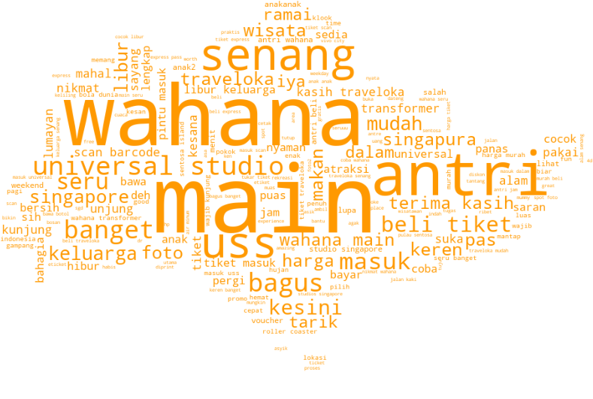


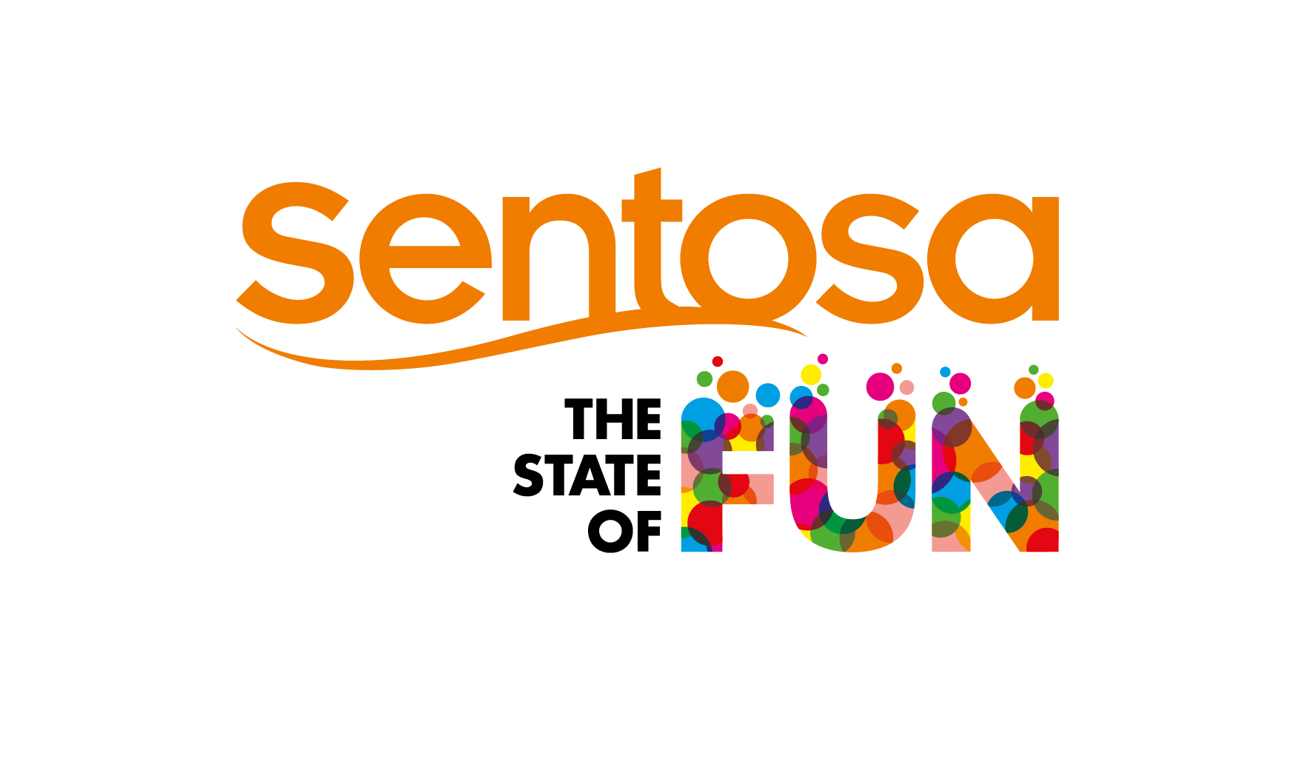
SDC GIE NLP
Sentosa Development Corporation: Guest Experience Feedback Insights
Project Description & Benefits
Extract publicly available data posted online from social media platforms and travel reviews by overseas visitors to Sentosa in their native languages (non-English) to analyse one of the four biggest tourists’ countries specified (India, Malaysia, China, Indonesia) for brand monitoring and market trends identification.
Natural Language Processing (NLP) provides meaningful insights into potential service keywords and sentiments useful for strategizing market share growth and customer satisfaction improvement.
Bahasa Indonesia word cloud
Solution
Minimum viable product (MVP) with multi-lingual textual data pre-processing and visualization for informal socio-linguistics such as emoji/emoticon and slang/abbreviation utilizing web-scrapping, Part-of-speech (POS) tagging, n-grams (uni-grams / bi-grams / tri-grams), topic modelling and labelling, word clouds, sentiment analysis and text summarization.
Industry Partner
Sentosa Development Corporation (SDC)
39 Artillery Avenue Singapore 099958
www.sentosa.gov.sg / www.sentosa.com.sg
(65) 6275 0388 (phone) / 6274 774 (fax)
Team IC
Alfred Tan Hsien Boon
21066499@myrp.edu.sg
Project Members
Luqman Hakim Bin Abdullah
21066645@myrp.edu.sg
Kelvin Thor 21066261@myrp.edu.sg
Ng Shu Wee Gina
21066631@myrp.edu.sg
Tan Hui Zi, Odelia
21066364@myrp.edu.sg
Notes:
The fonts are embedded in the PPT slide
You can change the font sizes to get a desirable fit
The smallest font size used should be 26 for main content, 22 for captions
To change the photo, right click > Change Picture…
When adding more photos, duplicate the current photo to achieve a consistent style

